Slide 1

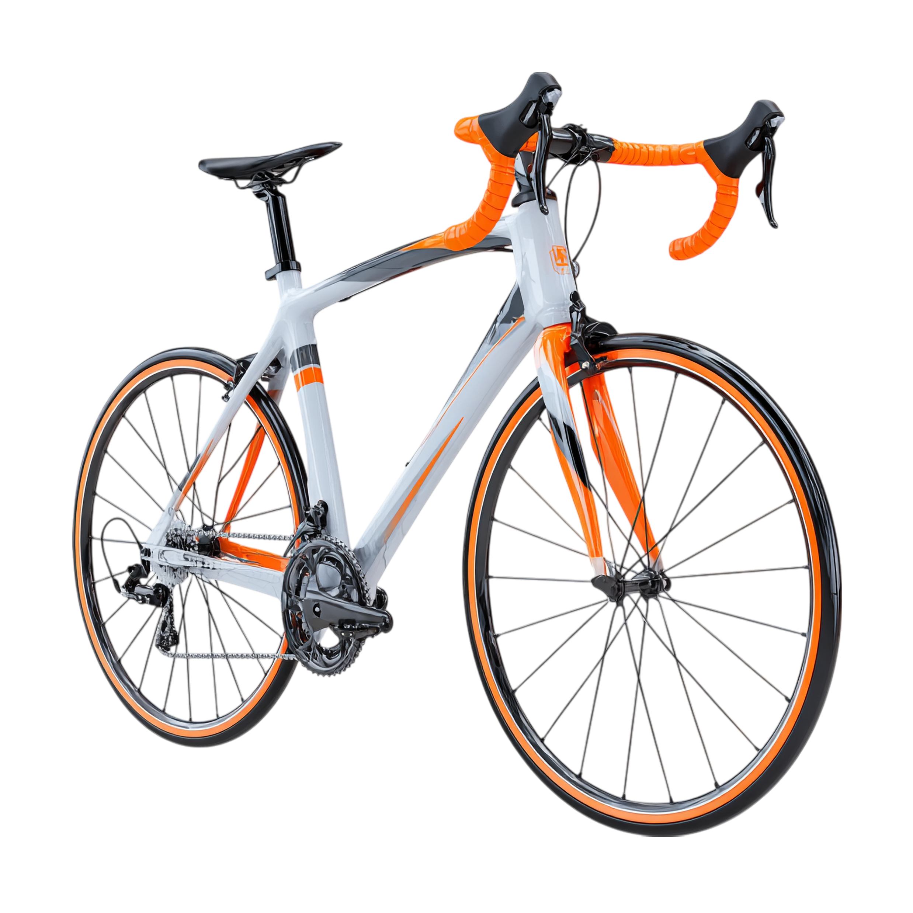
Cyclistic Bike-Share Analysis 2024
By Ahmed Magdy
Google Capstone Project

Slide 2

Project Summary Points
Google Capstone Project

Slide 3
Goal: Analyze usage differences between casual riders and annual members.
Tools: R, Tableau, Excel.
Data: 5.8M trips from January–December 2024.
Deliverables: Clean dataset, visual insights, and data-driven recommendations.
Google Capstone Project

Slide 4
Key Insights Overview
Google Capstone Project

Slide 5
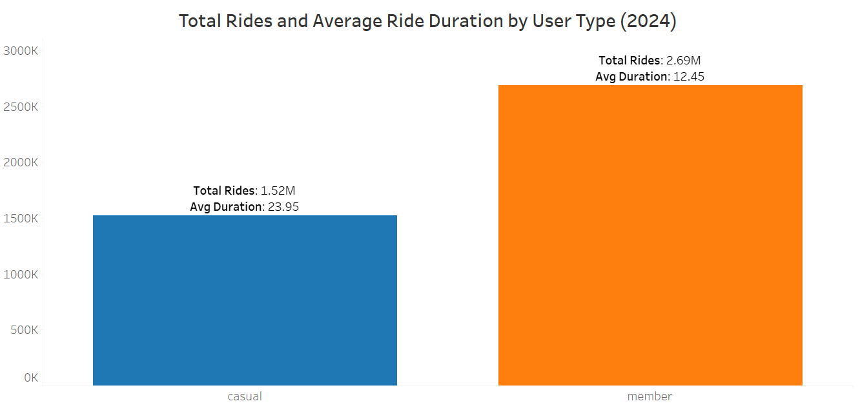
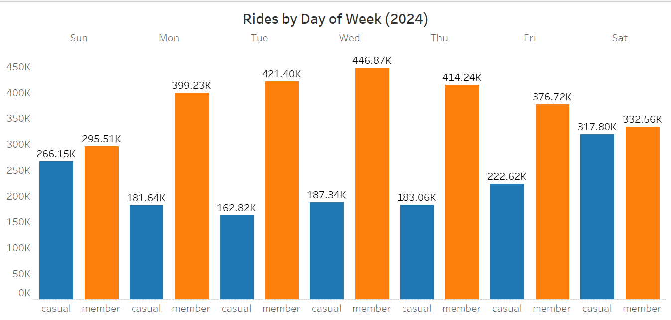
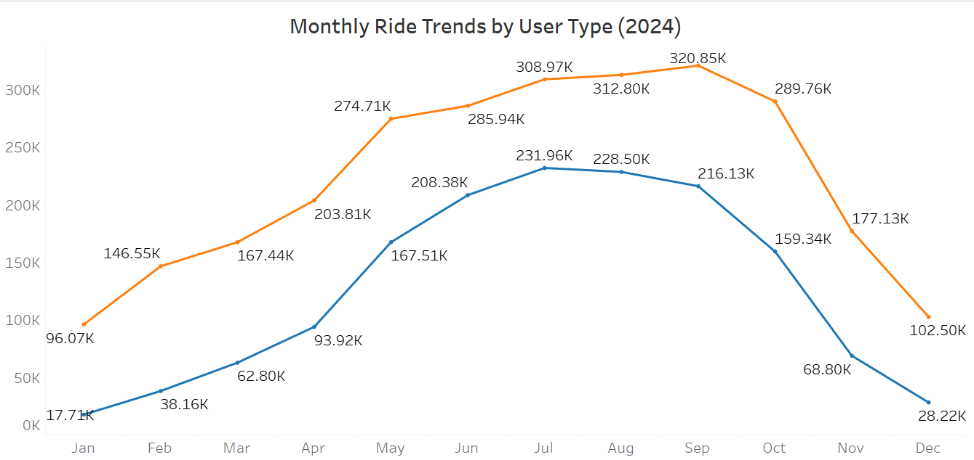

Total Rides & Average Ride Duration by User Type
Rides by Day of Week
Rides by Month
Sunday is the busiest riding day overall, driven by high usage from both member and casual users, while mid-week days (Tuesday, Wednesday, Thursday) show the lowest total casual usage.
Ride volume increases sharply in summer months, peaking around July for both groups.
Members take more total rides, while casual riders have longer average trip durations.
Google Capstone Project

Slide 6
Ride Patterns: Members vs Casuals (2024)
Google Capstone Project

Slide 7
Members record nearly twice as many rides as casual users,
but casual riders take longer trips on average.
Google Capstone Project

Slide 8
Member Riders:
Total Rides: 2.69 Million.
Average Duration: 12.45 minutes.
Casual Riders:
Total Rides: 1.52 Million.
Average Duration: 23.95 minutes.
Comparison:
Member rides are approximately 1.77 times the volume of casual rides (2.69M vs. 1.52M) , while the average casual ride duration is almost double the member ride duration (23.95 min vs. 12.45 min).
Google Capstone Project

Slide 9
Rides by Day of Week (2024)
Google Capstone Project

Slide 10
Member dominance peaks on the traditional workday, while casual users drive volume on the weekend and the start of the week. The member base shows a clear weekday commuter pattern, but the single highest total volume occurs on Wednesday, driven by an extreme member peak, which suggests an operational vulnerability if that single day's demand is not met.
Google Capstone Project

Slide 11
Members record the highest activity mid-week, peaking on Wednesday (446.9K rides) — indicating weekday commuting patterns.
Casual riders are most active on weekends, especially Saturday (317.8K rides) — suggesting leisure or tourism usage.
Member rides remain stable throughout the week, while casual usage spikes sharply on weekends.
Weekday vs. Weekend pattern
Member usage remains consistent through the week, while casual usage spikes sharply on weekends.
Lowest activity for casual users occurs on Tuesday (162.8K rides), showing limited weekday engagement.
Google Capstone Project

Slide 12
Monthly Ride Trends by User Type (2024)
Google Capstone Project

Slide 13
Both member and casual usage surge during warmer months, with members showing stable commuting patterns and casual riders driven by seasonal leisure demand.
Google Capstone Project

Slide 14
Members maintain consistently higher usage, peaking in August (320.9K rides) — 3.3× more than casual users that month (97.7K rides).
Casual riders show a sharp seasonal rise, increasing from 17.7K in January to 231.9K in July, a 13× growth, before declining after September.
Member Usage also follows a seasonal trend but remains more stable — rising gradually from 96.1K in January to its peak in August, then dropping toward December (102.5K).
Both groups experience a significant decline in late autumn and winter (Oct–Dec), indicating strong weather dependency.
Google Capstone Project

Slide 15
Rides by Season (2024)
Google Capstone Project

Slide 16
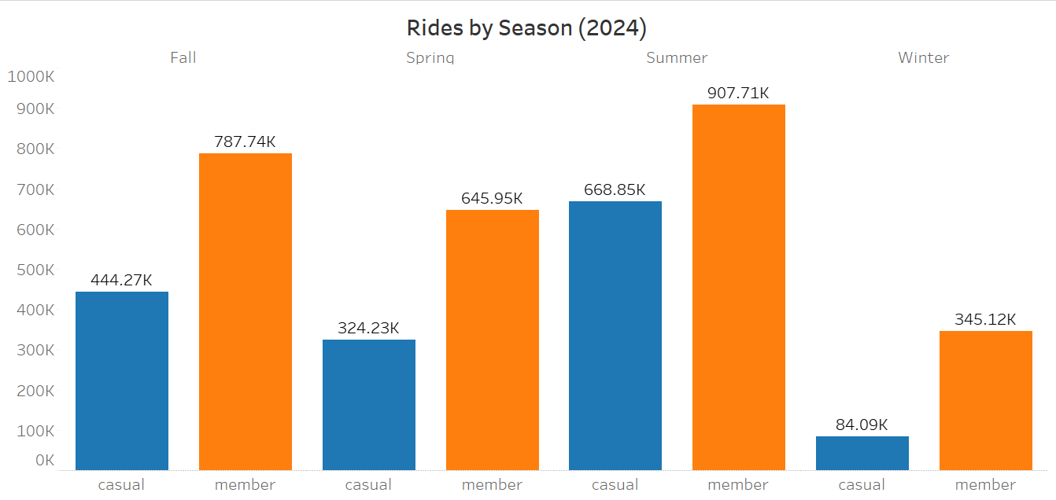
Summer leads with the highest ridership for both user types, while winter sees the sharpest decline — highlighting the strong impact of seasonality on demand.
Google Capstone Project

Slide 17
Summer dominates with the highest activity — Members: 907.7K rides, Casuals: 668.9K, together representing over 45% of annual rides.
Fall follows closely, with member rides at 787.7K and casual at 444.3K, indicating sustained demand after summer.
Spring shows moderate usage (Members: 646K, Casuals: 324K), marking the start of growth in ridership.
Winter has the lowest engagement (Members: 345K, Casuals: 84K) — roughly 75% lower than summer totals, confirming strong weather influence.
Across all seasons, members consistently ride more, but casuals narrow the gap in summer, showing their behavior is more seasonally driven.
Google Capstone Project

Slide 18
Rides by Day Type (Weekday vs Weekend, 2024)
Google Capstone Project

Slide 19
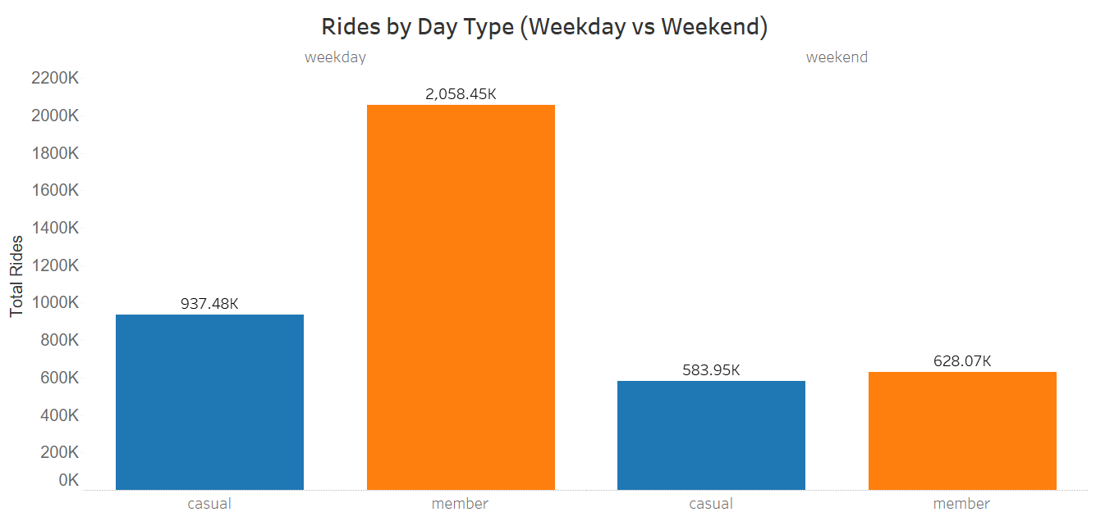
Members drive weekday ridership, while casual users boost weekend traffic — highlighting Cyclistic’s dual audience of commuters and leisure riders.
Google Capstone Project

Slide 20
Members dominate weekdays, completing 2.06 million rides, compared to 937K rides by casual users — roughly 2.2× more weekday activity.
Casual riders are more active on weekends (584K rides) than members (628K rides) — the only time their engagement nearly equals member usage.
The clear weekday–weekend split suggests two major user behaviors:
Members → daily commuters who use the service for routine travel.
Casuals → leisure or tourist riders preferring weekends and short trips.
Together, weekdays account for nearly 78% of total rides, confirming Cyclistic’s reliance on consistent commuter demand.
Google Capstone Project

Slide 21
Project Summary
Google Capstone Project

Slide 22
Goal: Analyze how different customer types (members vs. casual riders) use Cyclistic bikes and identify strategies to convert casual riders into members.
Key Findings
Members: 2.69M rides in 2024, averaging 12.4 minutes per ride — consistent weekday commuters.
Casual Riders: 1.52M rides, averaging 24 minutes per ride — primarily weekend and seasonal users.
Peak Usage: Summer (June–August) and weekdays (especially Wednesday) show the highest ridership.
Off-Peak: Winter months and early weekdays have the lowest activity.
Behavioral Pattern: Members = predictable commuters, Casuals = flexible leisure riders.
Analytical Tools
R, Tableau, Excel — used for data cleaning, trend analysis, and visualization.
Google Capstone Project

Slide 23
Business Recommendations
Google Capstone Project

Slide 24
1. Marketing & Conversion
Develop targeted weekend campaigns promoting membership to casual users during summer peaks.
Offer discounted “Weekend-to-Member” packages or free trial weeks for casual riders who exceed a ride threshold.
Leverage in-app notifications to promote commuter benefits (cost savings, convenience).
2. Operations & Fleet Optimization
Increase bike availability in tourist and recreation zones during weekends and summer months.
Shift maintenance and redistribution to early weekdays when ride volume is lower.
3. Retention & Engagement
Introduce a Loyalty Program rewarding members for consistent weekday rides.
Launch seasonal engagement campaigns during low-demand months (winter).
Google Capstone Project

Slide 25
Conclusion
Google Capstone Project

Slide 26
The analysis reveals two distinct customer profiles:
Members form the operational backbone of Cyclistic — consistent, reliable, and weekday-focused.
Casual riders represent the greatest growth opportunity — highly seasonal but convertible with the right offers.
By aligning marketing, operations, and pricing strategies with these behavioral patterns, Cyclistic can increase membership conversions, improve resource allocation, and enhance overall profitability.
Final takeaway: Data-driven segmentation is key — turning insights into targeted actions is what transforms analytics into business success.
Google Capstone Project

Slide 27
Thanks
Google Capstone Project

